Slide 1

VOICE ASSISTANT WITH COMPUTER VISION A Project Work Submitted for the fulfillment of Degree of Bachelor of Technology (B. Tech) In Computer Science & Engineering (Session: 2021-22)
Krishna Vishwakarma (0213CS181040)
Rammani Shukla (0213CS193D08)
Animesh Jain(0213CS181016)
Gautam Marko (0213CS181032)
Under the Guidance of
(Prof. Prateek Gupta)H.O.D.
(Computer Sci. & Engineering)
DEPARTMENT OF COMPUTER SCIENCE & ENGINEERING SHRI RAM INSTITUTE OF SCIENCE &TECHNOLOGY, JABALPUR (M.P.)
RAJIVV GANDHI PROUDYOGIKI VISHWAVIDYALAYA, BHOPAL (M.P.),

Slide 2
1. Introduction
2. Analysis
3. Design
4. Tools Use
5. Result
6. Future Enhancement
7. Reference

Slide 3
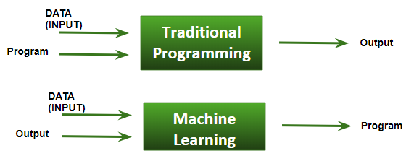
Introduction
Today, we can ask voice assistants like Apple’s Siri, and Google Now to perform simple tasks like, “What’s the weather”, etc. in our own natural language. The next evolution of natural language interaction with voice assistants is in the form of task automation They can launch apps, open web browsers, answer basic informational queries, tell calculate your BMI, answer our queries, play music, send an email, set reminders, make lists, and do basic math calculations, etc
The voice assistant is design to make the work easier of the user. As user can give command to them without making visual access to the screen. the security features of “Face Recognition” is designed so that it can detect the authorized user face and take user command as input and provide response via a synthesis voice.
FUTURE SCOPE
Using this system as a framework, the system can be expanded to features security. Security is important these days so it can be combined with this system to give more advanced security features. In this, the voice authentication technology can be implemented for more security. More advancement are possible like operating on various tones or accents from different regions that mean it should be able to perform operations on various voice tones and accents

Slide 4
Analysis
How does voice assistant work?
The assistant needs a keyword in order to begin the conversation. The assistant jumps into action when you say a specific keyword. In general, keyword includes an assistant name along with greeting.The assistant then listens to what you say by the microphone (mic) in your laptop. Furthermore, the assistant then interprets or understand what you said by natural language processing. In most of the cases, voice assistants are connected to neural networks via the internet. Neural networks and artificial intelligence together help assistant to understand the context of human language.
Software requirement specification
A software requirements specification (SRS) is a document that captures a complete description of how the system is expected to perform. It is usually signed off at the end of the requirements engineering phase.
Functional requirement
Face recognition starting, Advanced Motion detection for better security, Searching on Wikipedia, Searching on Google and playing YouTube video, Find information online on weather, Play your music, Showtime, Calendar, Open apps on your windows, Open the website on your windows, Real-time has spoken assistant , Find a place on google maps, Write notes & show note, Answer some normal conversation, Play Audiobook, Tell some jokes , Take a screenshot

Slide 5
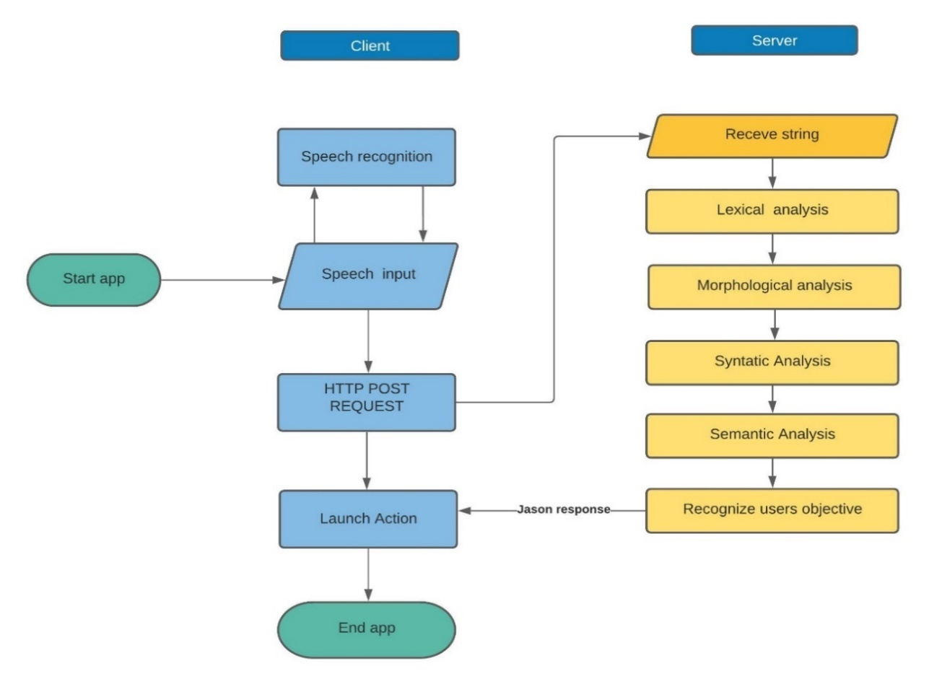
Design
Working diagram of Jay personal assistant

Slide 6
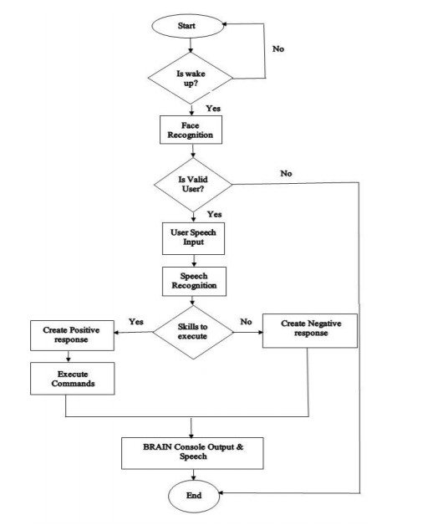
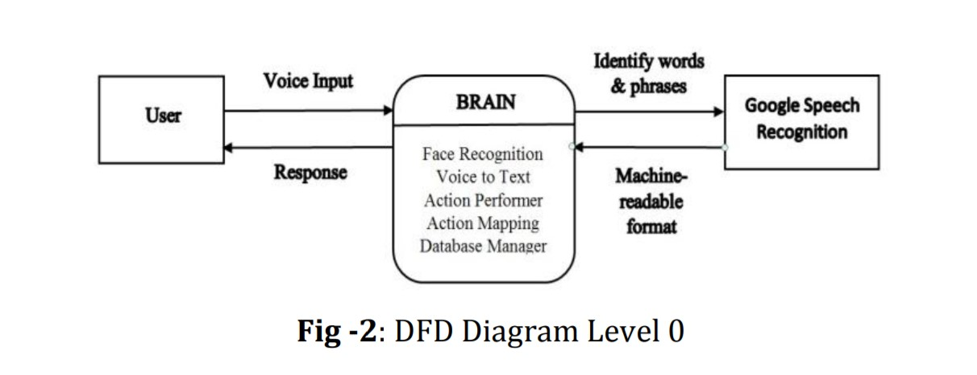
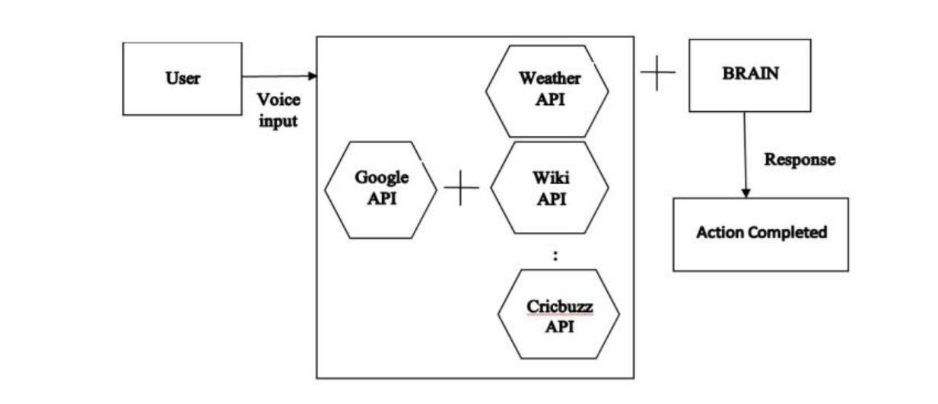
DATA FLOW DIAGRAM DFD
DFD is a graphical representation which provides information flow between input and output data. It is also known as “Data Flow Chart or Bubble Chart”. A DFD is often
used as a preliminary step to create an overview of the system, which can later be elaborated.
Level 0 DFD:
FLOW CHART
Level 1 DFD:

Slide 7
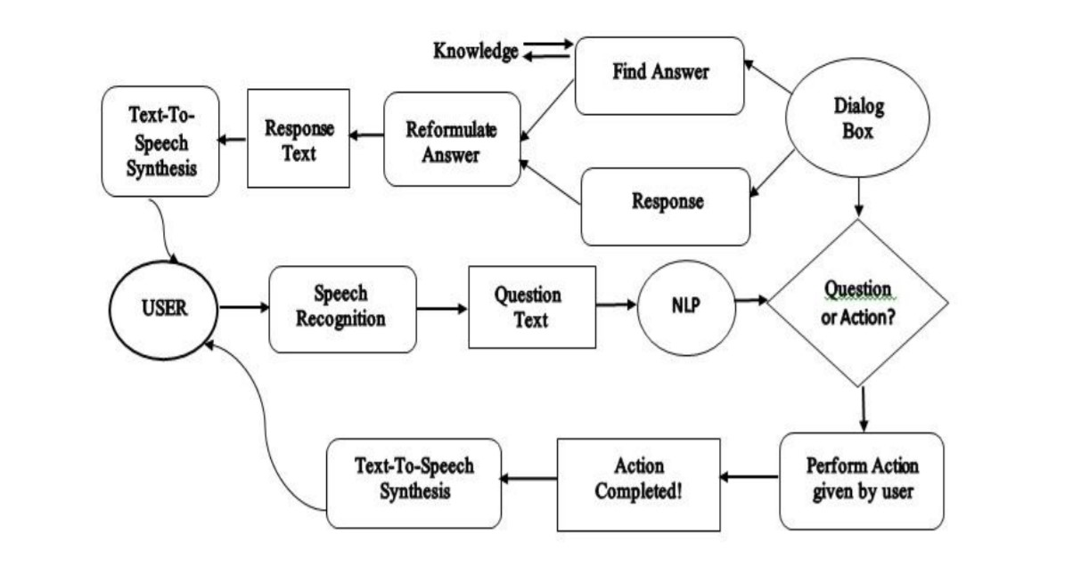
SYSTEM DESIGN AND IMPLEMENTATION

Slide 8
Tools Use
Requirement for virtual assistant.
Hardware
I3 processor or later
RAM 4 GB or more
Mic & speaker
Good internet connectivity
Software:
Windows 10(64-bit).
Python 3 or later
Chrome Driver
Google weather API
Tools for Making projects:
Visual Studio Code
Python
MySQL
OpenCV

Slide 9
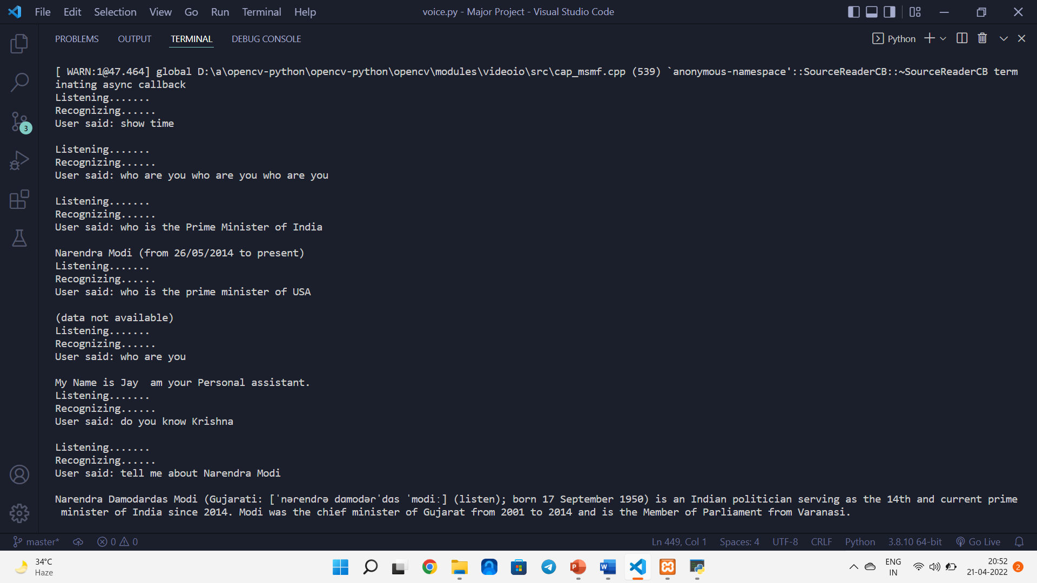
Result

Slide 10
Reference
Websites referred
www.stackoverflow.com
www.google.com
www.geeksforgeeks.com
www.python.org
www.w3school.com
https://opencv.org
YouTube Channels referred
Codewithharry
ProgramingHero

